Slide 1
Text Mining Project
Second report for Tweets analyzing
Dong Han
dhan@oakland.edu

Slide 2
Overview
Review the objective of the project
Measure the quality of clustering
Analyze the collected data
The experiment to cluster tweets to subtopics from a hash tag searched results.
The experiment to find the best number of subtopics
The experiment to extract the main idea of each subtopics
Discussion

Slide 3






Review the objective of the project (Cont.)
After retrieving search results for a hash tag, we want to cluster the results to a few subtopics.
Example: a search result for #apple
Cluster the tweets to subtopics
iPhone devices features
Apple’s watch
iOS features

Slide 4


Review the objective of the project
Motivation: Some tweets have correlations, but they do not exactly use the same terms to describe a similar topics.
To analyze the similarity of tweets, in the project, we propose to use latent semantic indexing(LSI) to preprocess tweets before clustering.
Original term-document Matrix
=
SVD term matrix
SVD
$$×$$
singular values
$$×$$
SVD
document matrix

Slide 5


Review the objective of the project
Motivation: Some tweets have correlations, but they do not exactly use the same terms to describe a similar topics.
To analyze the similarity of tweets, in the project, we propose to use latent semantic indexing(Latent Semantic Indexing) to preprocess tweets before clustering.
Do cluster based on the SVD document matrix
Original term-document Matrix
=
SVD term matrix
SVD
SVD
document matrix
$$×$$
singular values
$$×$$

Slide 6
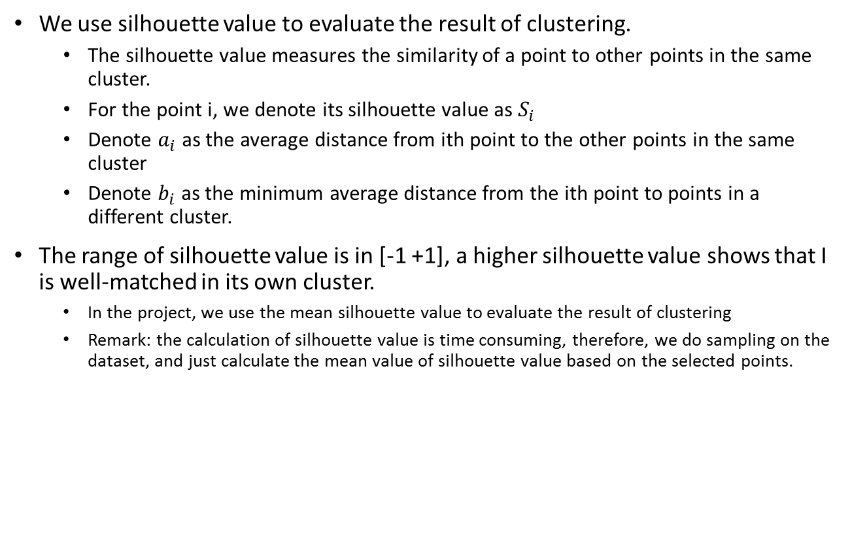
Get appropriate number of clusters
We use silhouette value to evaluate the result of clustering.
The silhouette value measures the similarity of a point to other points in the same cluster.
For the point i, we denote its silhouette value as $S_{i}$
Denote $a_{i}$ as the average distance from ith point to the other points in the same cluster
Denote $b_{i}$ as the minimum average distance from the ith point to points in a different cluster.
The range of silhouette value is in [-1 +1], a higher silhouette value shows that I is well-matched in its own cluster.
In the project, we use the mean silhouette value to evaluate the result of clustering
Remark: the calculation of silhouette value is time consuming, therefore, we do sampling on the dataset, and just calculate the mean value of silhouette value based on the selected points.
i

Slide 7




Get appropriate number of clusters
We use silhouette value to evaluate the result of clustering.
The silhouette value measures the similarity of a point to other points in the same cluster.
For the point i, we denote its silhouette value as $S_{i}$
Denote $a_{i}$ as the average distance from ith point to the other points in the same cluster
Denote $b_{i}$ as the minimum average distance from the ith point to points in a different cluster.
The range of silhouette value is in [-1 +1], a higher silhouette value shows that I is well-matched in its own cluster.
In the project, we use the mean silhouette value to evaluate the result of clustering
Remark: the calculation of silhouette value is time consuming, therefore, we do sampling on the dataset, and just calculate the mean value of silhouette value based on the selected points.
$$d_{1}$$
$$d_{2}$$
$$d_{4}$$
i
$$d_{3}$$

Slide 8



Get appropriate number of clusters
We use silhouette value to evaluate the result of clustering.
The silhouette value measures the similarity of a point to other points in the same cluster.
For the point i, we denote its silhouette value as $S_{i}$
Denote $a_{i}$ as the average distance from ith point to the other points in the same cluster
Denote $b_{i}$ as the minimum average distance from the ith point to points in a different cluster.
The range of silhouette value is in [-1 +1], a higher silhouette value shows that I is well-matched in its own cluster.
In the project, we use the mean silhouette value to evaluate the result of clustering
Remark: the calculation of silhouette value is time consuming, therefore, we do sampling on the dataset, and just calculate the mean value of silhouette value based on the selected points.
$$d_{1}$$
$$d_{2}$$
$$d_{4}$$
$$a_{i}=\frac{{d_{1}+d}_{2}}{2}$$
i
$$b_{i}=\frac{{d_{3}+d}_{4}}{2}$$
$$d_{3}$$
$$S_{i}=(b_{i}−a_{i})/max⁡(a_{i},b_{i})$$

Slide 9
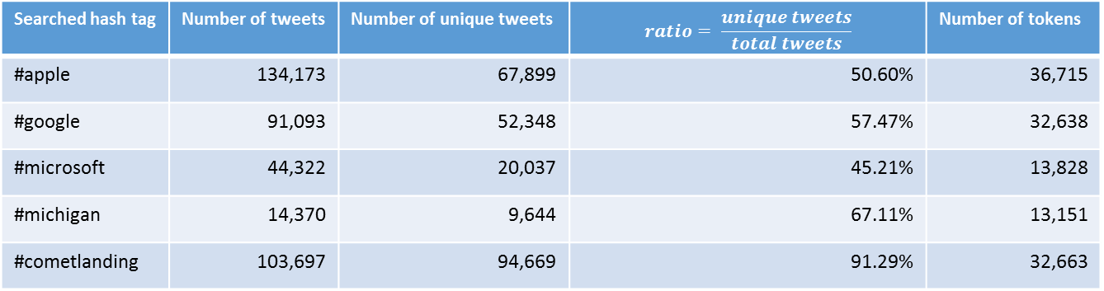
Analyze the collected data
We collect results from five different hash tags for 11 days, in the period from Nov. 7, 2014 to Nov. 17, 2014. The basic statistics of results are shown in the table.
Searched hash tag | Number of tweets | Number of unique tweets | $$ratio= \frac{unique tweets}{total tweets}$$ | Number of tokens
#apple | 134,173 | 67,899 | 50.60% | 36,715
#google | 91,093 | 52,348 | 57.47% | 32,638
#microsoft | 44,322 | 20,037 | 45.21% | 13,828
#michigan | 14,370 | 9,644 | 67.11% | 13,151
#cometlanding | 103,697 | 94,669 | 91.29% | 32,663

Slide 10
Build term-document matrix
Issue: the term-document matrix is huge.
For example: we build a term-document for “#apple”
Number of term = 36,715
Number of tweets = 67,899
The scale of the term-document matrix is
36715*67899 = 2,492,911,785
If we use 32bits(4bytes) integer type to store one element, it needs approximately 10GB storage space just to store the matrix.
Solution:
Because each tweet has no more than 140 characters, many elements in the matrix have value 0. Therefore, the density of term-document matrix is low.
We use sparse matrix for storage and further processing.
Searched hash tag | Density
#apple | 0.0249%
#google | 0.0239%
#microsoft | 0.0565%
#michigan | 0.0609%
#cometlanding | 0.0220%

Slide 11
The efficiency of SVD on sparse matrix
We build a random 100000x10000 sparse matrix, the scale of the matrix is near to the scale of term-document matrix of tweets.
We initialize the matrix with specified density. Then we do SVD for the matrix.
We run the SVD operation on AMD FX-9590 Eight-Core 4.71 GHz Processor.
The result shows that the scale likes the tweets’ term-document matrix can apply the SVD and get solved with in tolerable time ( less than 1 minute).

Slide 12
The SVD operation on Tweets’ term-document matrix

Slide 13
LSI analysis

Slide 14
LSI analysis

Slide 15
Analyze Silhouette value

Slide 16
Discussions

